Slide 1

Water Cycle VR GUIDE
Water Cycle
VR Guide
Presented By
Adnan Ali 201520023
Zainab Shahid 201520629
Supervised by
Dr. Saqib Iqbal

Slide 2
Content
Introduction
Requirement Analysis
Design
Implementation
Testing
Conclusion
Reference

Slide 3
Introduction
Virtual Reality (VR) allows the user to have a visual view of scenario that might not be easily accessible
Being one of the top trending technology it will help evolve the education sector as well
Developed application will allows kids to visualize Earths water cycle and easier for them to understand
As kids love to play games, we will include a mini game as it will make it easier to pass information to them.

Slide 4
Requirement Analysis
Our application includes three main modules:
Main Menu
Tour Guide
Game Mode

Slide 5
Main Menu Module
R1: The application shall allow user to select Tour Guide/Game or Exit the application
Tour Guide
R2: The application shall guide the user with robot companion.
R3: The application shall pass the user through all the water cycle phases.
R4: The application shall allow user to look around.
Mini Game:
R5: The application shall allow user to move player as needed.
R6: The application shall limit user gameplay time.
R7: The application must record user gameplay time for high score.

Slide 6
Design
System architecture establishment, component and deployment diagrams
Components: whole system is decomposed into Components
Main Menu
Tour Guide
Game Mode

Slide 7
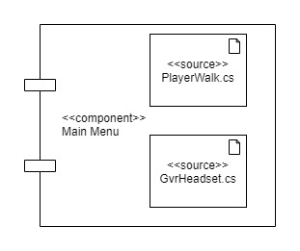
Main Menu Module

Slide 8
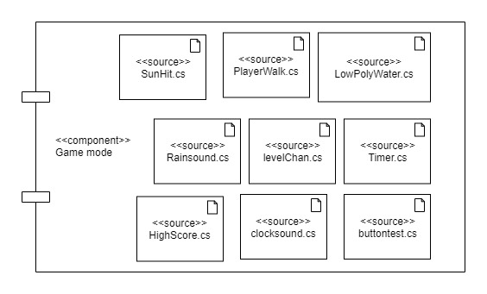
Game Mode Module

Slide 9
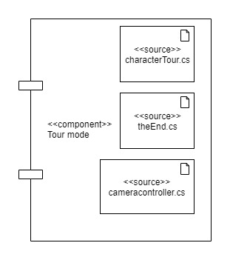
Tour Mode Module

Slide 10
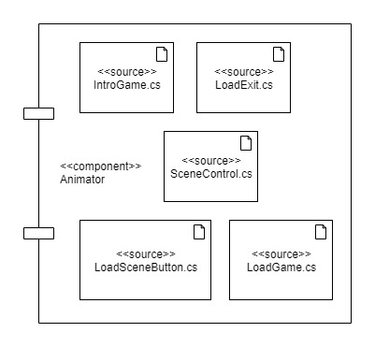
Animator Module

Slide 11
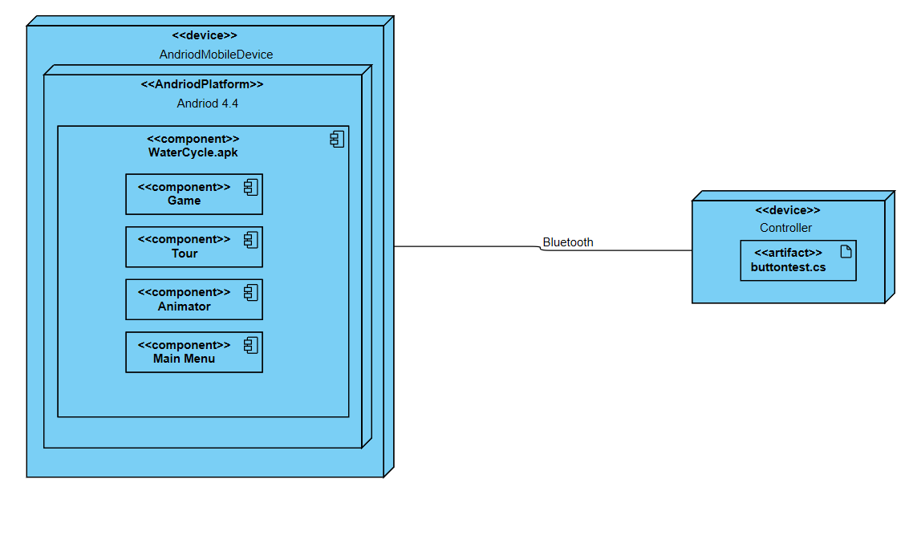
Deployment Diagram

Slide 12
Implementation
Application implementation
Hardware and Software requirements
User Interface

Slide 13
Software options
Two Main Options : Unity/Un-real
Chose Unity
Why unity ?
particle system management
Animator control
Platform support
Microsoft Visual Studio
Better integration with unity

Slide 14
Hardware Description
VR headset
Android Device
Bluetooth Controller

Slide 15
Testing
Testing is done to:
The software meets its requirements.
To identify and reveal as many errors as possible in the tested software.
To perform the required tests efficiently and effectively, within budgetary and scheduling limitations.
Types of System Tests
Functional testing
Non- functional testing
Testing techniques
Functional testing: Equivalence class partitioning (ECP) & State transition testing.
Non-functional: Survey

Slide 16
Unit Testing
Test Case ID | Test Scenario | Test Case Description | Precondition | Test Steps | Expected Results | Actual Result | Test Result
TC_0017 | Moving the player. | Testing the functionality of moving the player by moving 360˚ rocker to right | The user must be in game. | Move the 360 ˚ Rocker to right | Player moved to right. | Player moved to right. | Pass
TC_0018 | Moving the player. | Testing the functionality of moving the player by moving 360˚ rocker to right | The user must be in game. | Move the 360 ˚ Rocker to left | Player moved to left. | Player moved to left. | Pass
TC_0019 | Moving the player. | Testing the functionality of moving the player by moving 360˚ rocker to right | The user must be in the game. | Move the 360 ˚ Rocker upwards. | Player moved to forward. | Player moved forward. | Pass
TC_0020 | Moving the player. | Testing the functionality of moving the player by moving 360˚ rocker to right | The user must be in the game. | Move the 360 ˚ Rocker downward. | Player moved to backward. | Player moved to forward. | Fail

Slide 17
System Testing
Test Case ID | Test Scenario | Test Case Description | Precondition | Test Steps | Test Data | Expected Results | Actual Result | Test Result
STC_001 | Testing the flow of the user entering the tour and exiting it | The user will enter the tour by gazing at the start tour button for 2 seconds, then the user will the tour with button A. | App is launched. | User gazes at the start tour button for 2 seconds. | Gaze at the start tour button for 2 seconds. | User enters the tour. | User enters tour. | Pass
 |  |  |  | User presses Button A to exit the tour | Button A | User exits the tour. | User exits the tour.
STC_002 | Testing the flow of the user entering the game, playing the game and exiting it. | The user will enter the game by gazing at the Start Game for 2 seconds, plays the game and then the user exits the Game with button A. | App is launched. | User gazes at the Start Game button for 2 seconds. | Gaze at the start game button for 2 seconds. | User enters the game. | User enters the game. | Pass
 |  |  |  | User moves the player right. | Move the 360 ˚ Rocker to right. | Player moves right. | Player moves right.
 |  |  |  | User moves the player left. | Move the 360 ˚ Rocker to left. | Player moves left. | Player moves left.
 |  |  |  | User exits the Game. | Button A | Player exits the game. | Player exits the game.

Slide 18
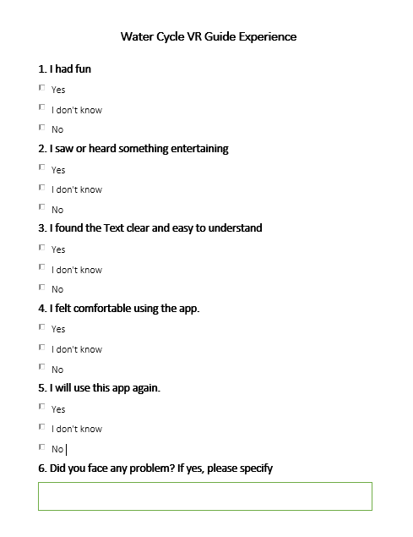
Usability Testing
SURVEY

Slide 19
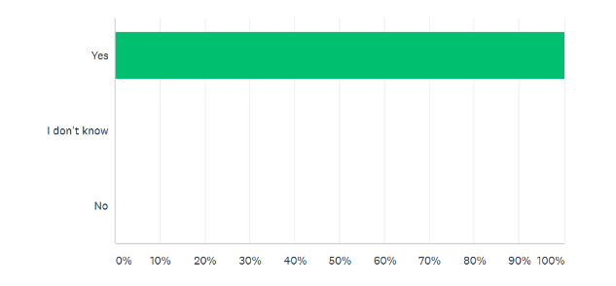
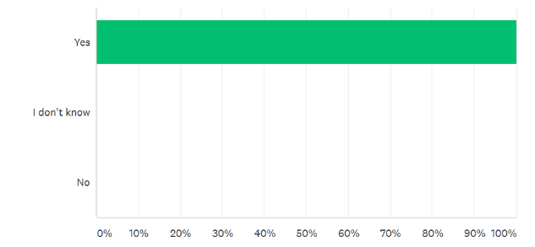
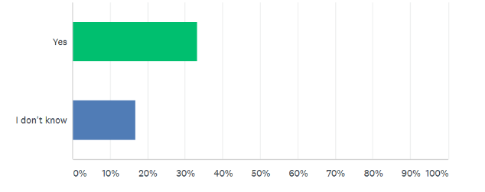
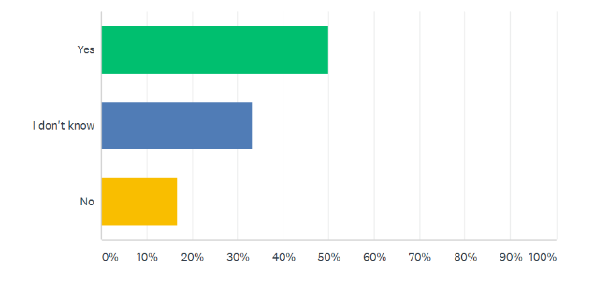
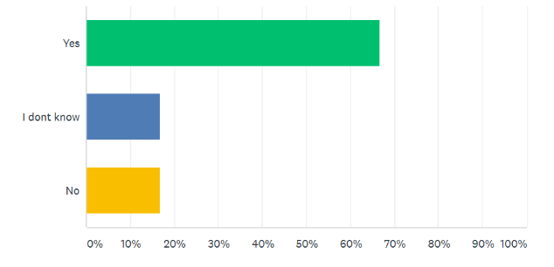
Unit Testing Results
I saw or heard something entertaining
I had fun
I felt comfortable using the app.
I found the text clear and easy to understand
I will use this app again

Slide 20
Conclusion
Water cycle is an important concept and essential to all living organisms.
There are very few VR apps that takes the user through a virtual tour of the water cycle.
The project is a Virtual Reality application to ease the understanding of water cycle for students. It consists of:
Visual view of the water cycle
Mini game to polish up user’s knowledge.

Slide 21
Future Work
The project can be improved in the future by implementing:
Improved Graphics
Text-to-Speech Conversion of the tutorial
Better Animations
Different Languages’ Support
More Games

Slide 22
Thank you
Questions?

